Slide 1
Build application with Spring
Course “Spring – first touch”
Section 6

Slide 2
Agenda
Spring and other frameworks
Database access
Spring and Web app

Slide 3
Three problems
Application size
Integration
Configuration

Slide 4
Addressed problem
Application size
Integration
Configuration

Slide 5
SPRING AND OTHER FRAMEWORKS

Slide 6

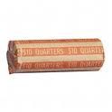
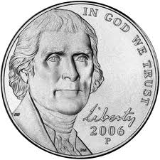
Integration with Spring
Technology
Spring Wrapper
Spring Container

Slide 7
Hibernate and Spring integration
Hibernate
Spring SessionFactory Wrapper
SessionFactory bean inside Spring Container

Slide 8
DATABASE ACCESS

Slide 9
Database access from Java
Your vision …

Slide 10
Database access from Java
JDBC
SQL mapping frameworks
  iBATIS/MyBATIS
ORM frameworks
  Hibernate
  TopLink
Transactions, DataSources, Connection pools, etc.

Slide 11
Out target
Show how to setup and configure:
  JDBC datasource
  Hibernate
  Transactions
with Spring

Slide 12
Data source main parameters
JDBC driver class
JDBC connection url
User
Password

Slide 13
Data source configuration
<bean id="dataSource" class="org.apache.commons.dbcp.BasicDataSource"
destroy-method="close">
<property name="driverClassName" value="org.hsqldb.jdbcDriver"/>
<property name="url"
value="jdbc:hsqldb:mem:."/>
<property name="username" value="sa"/>
<property name="password" value=""/>
</bean>

Slide 14
Hibernate setup
Annotated entities
Properties
  hibernate.properties
Configuration file
  hibernate.cfg.xml
Introduce Hibernate inside Spring container

Slide 15
JPA annotated entity
@javax.persistence.Entity
@Table(name="ENTITIES")
public class Entity {
@Id
@GeneratedValue
@Column(name="PK")
private Long pk;
@Column(name="NAME")
private String name;

Slide 16
Hibernate Session Factory
<bean id="sessionFactory" class="org.springframework.orm.hibernate3.
annotation.AnnotationSessionFactoryBean">
<property name="dataSource" ref="dataSource" />
<property name="packagesToScan" value="lv.courses.spring.entities"/>
<property name="hibernateProperties">
<props>
<prop key="hibernate.dialect"> org.hibernate.dialect.HSQLDialect</prop>
<prop key="hibernate.show_sql">true</prop>
<prop key="hibernate.format_sql">true</prop>
<prop key="hibernate.hbm2ddl.auto">create</prop>
</props>
</property>
</bean>

Slide 17
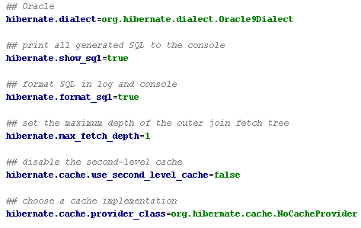
Hibernate properties example

Slide 18
Database query examples
public class RealDatabase {
private HibernateTemplate hibernateTemplate;
public RealDatabase(SessionFactory sessionFactory) {
this.hibernateTemplate = new HibernateTemplate(sessionFactory);
}
public void saveEntity(Entity entity) {
hibernateTemplate.save(entity);
}
public List<Entity> getAllEntities() {
return hibernateTemplate.find("from Entity");
}

Slide 19
SPRING AND WEB APP

Slide 20

Integrate Spring with
Java-based Web application

Slide 21
Define context parameter inside web.xml
<context-param>
<param-name>
contextConfigLocation
</param-name>
<param-value>
/WEB-INF/
classes/applicationContext.xml
</param-value>
</context-param>

Slide 22
Define listener inside web.xml
<listener>
<listener-class>
org.springframework.web.context.
ContextLoaderListener
</listener-class>
</listener>

Slide 23
Integrate Spring with
Java-based Web application
WebApplicationContext ctx = WebApplicationContextUtils.
getWebApplicationContext
(servletContext);

Slide 24
Get Beans and use it
WebApplicationContext ctx = …;
ctx.getBean(String name);
OR
ctx.getBean(Class clazz);

Slide 25

Any Questions?

Slide 26

References
Spring in Action 2 edition
Spring documentation: http://www.springsource.org/documentation

Slide 27

Practice 5 and 6

